Slide 1
ASIS Academy
Automation by Scripting
Adam Shackleton

Slide 2
Course Agenda
1. Introduction to Python
- What is scripting; Why Python; Lighting Python lesson
2. Introduction to Automation
- What do we mean by automation; Interacting with files and the file system
3. APIs
- What’s an API; How to access them using Python
4. Databases
- Lighting SQL lesson; Creating and using database connections
5. Excel Files
- Pandas; Common Excel functions in Python

Slide 3
Today’s Agenda
Python tasks
Review of last week’s content
Jupyter Notebooks
Pandas
Data manipulation
Merging data
Further reading
Questions
Notes:
If you have questions throughout please put them in the chat and if anyone knows the answer they’re welcome to help me out, otherwise I’ll sweep them up before we go into the exercises
This isn’t a Python course – it’s a course about using python so the pace might be a bit fast – rest assured all the code I show as examples will be available when you’re working on the exercises

Slide 4


Tools we’ll use during our sessions
Python 3.10
VS Code
https://www.python.org/
https://code.visualstudio.com/
Notes:
This presentation and all the code I show is in the github repo I’ve shared in the chat

Slide 5
Last week recap
Notes:
Virtual environments
Databases

Slide 6

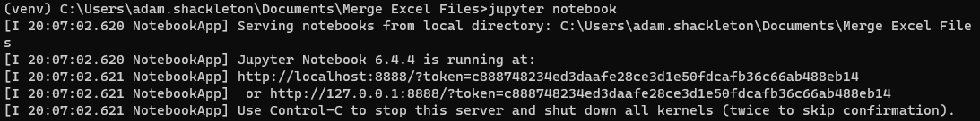
Jupyter Notebooks
Jupyter notebooks are a sort of cross between a script file and a command prompt
They allow you to write scripts in manageable sections, but also to run those scripts in the user interface and obtain the results
They can nicely display tabular and graphical data
They can be used like a notebook – adding text annotations and images
They can even be used to create presentations

Slide 7

Python – Pandas
We saw in an earlier session that we can read file data line by line and perform actions on it
That’s fine and can work well for simple tasks, but for more complicated actions we really need a dedicated data manipulation library – Pandas
Pandas has a couple of specific data structures that make labelling and manipulating large data sets much easier and more intuitive, and often times faster too
Pandas comes with a lot of functions specifically for merging, pivoting, indexing, and grouping data
This panda has nothing to do with Pandas the Python library, it’s just a panda

Slide 8

Python – Pandas
Pandas is a third party library, so you will need to use pip to install it (in a virtual environment), then it is imported as normal
Side note – if you want to import Excel files you need to also download an Excel file reader, I recommend openpyxl

Slide 9
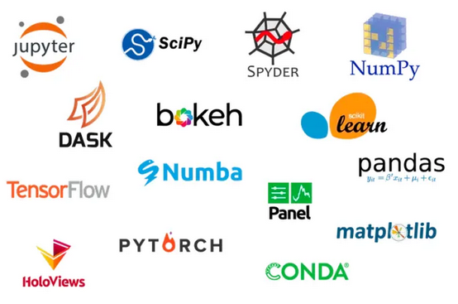

Further reading – Anaconda
Anaconda is a “Python distribution platform”
It’s very popular among data scientists and data analysts as it comes with most (if not all) of the common data packages already installed – so removes to need to install and keep track of dependencies for your projects
https://www.anaconda.com/products/distribution

Slide 10
Thank You

Slide 11
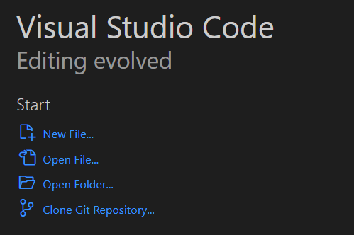
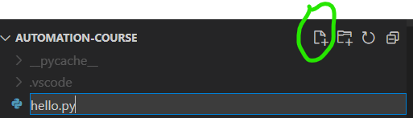
Checking it’s working – Hello World
Once Python and VS Code are installed, create a folder to hold your code and then open VS Code
When it opens, click Open Folder… and select your desired location
From the Explorer, click the new file icon and call it hello.py

Slide 12
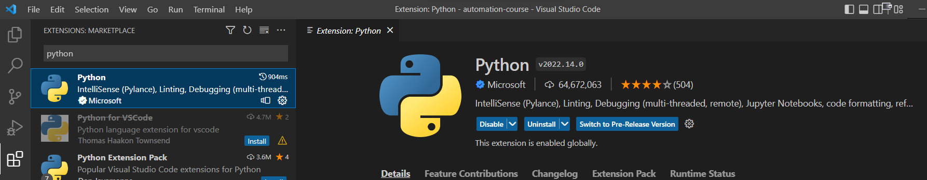
Checking it’s working – Hello World
There’s a good chance VS Code will recognise that you are running a python file and ask you to install the python extension, if not, go to the Extensions icon and search for it
Click the blue install button (shows as “Uninstall” in my screenshot)

Slide 13
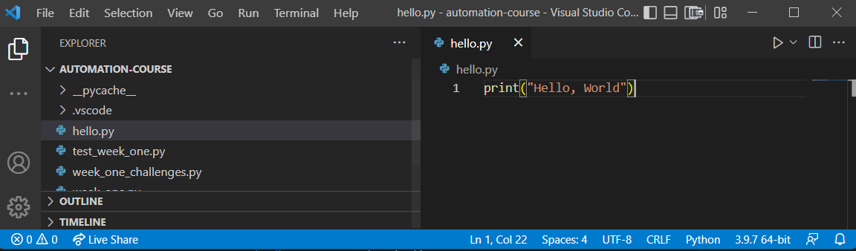
Checking it’s working – Hello World
Once that’s done, go to your hello.py file and type print(“Hello, World”)
Check that VS Code has recognised you have a Python interpreter, shown here as 3.9.7, and click the play button in the top right corner

